Slide 1

DATA CLEANING AND VISUALIZATION
Activity 2: Pearson Correlation Heatmap Analysis
Employee Dataset Analysis — 3-Minute Video Presentation

Slide 2
Data Cleaning Process
Issues Identified
Actions Taken
Missing values in key columns: Age, Salary, Name, Country, ID, and Join Date.
Duplicate records found, particularly for one employee entry.
Incorrect formats: Age column contained text values such as "thirty-eight" instead of numeric values.
Removed duplicate records from the dataset.
Converted text-based numbers into proper numerical format.
Replaced missing numerical values using the median.
Standardized date values into a consistent format.
Flagged invalid or missing categorical entries for review.
Result: The dataset is now accurate, consistent, and ready for analysis. All critical quality issues have been resolved.
Activity 2

Slide 3
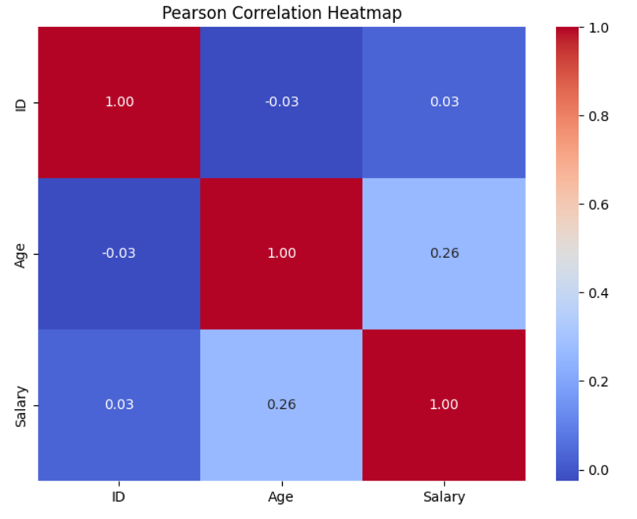
Pearson Correlation Heatmap
Correlation Scale
+1 — Perfect positive correlation
-1 — Perfect negative correlation
0 — No linear relationship
Key Finding
r ≈ 0.26
A weak positive correlation between Age and Salary. As age increases, salary tends to increase slightly, but the relationship is not strong.
The correlation between ID and other variables is close to zero, indicating no meaningful relationship.
Activity 2

Slide 4
Outlier Detection
Method: Interquartile Range (IQR)
Outliers are values that fall below Q1 − 1.5×IQR or above Q3 + 1.5×IQR.
Salary Outlier
Age Outliers
72,000
22, 35, 40
Significantly higher than most salary values in the dataset.
Potential age outliers detected using the IQR method.
Note: These values are not necessarily incorrect, but they are unusual compared to the rest of the dataset and may influence statistical analysis. Boxplots can clearly highlight these outliers.
Activity 2

Slide 5
Key Insights and Conclusion
Data Quality: Cleaning resolved missing values, duplicates, formatting errors, and inconsistencies, making the dataset reliable for analysis.
Correlation: A weak positive correlation (r ≈ 0.26) between Age and Salary suggests only a slight linear relationship.
Outliers: Unusual salary (72,000) and age values (22, 35, 40) were identified and may require further investigation.
Overall: This process demonstrates the critical importance of data cleaning and visualization in preparing reliable datasets for meaningful analysis and informed decision-making.
Thank You
Activity 2

